Slide 1
Project Presentation of CO-OP Project at Industry (Module-2) (22CS421)
On
<AI that predicts online shopping price drops and best buy time>
<Muskan Aggarwal, Dhruv Sehal>
<2210991946, 2210991511>
Supervised By
<Simarjit Kaur>
Department of Computer Science and Engineering,
Chitkara University, Punjab

Slide 2
Introduction
This research introduces an intelligent system named SmartPrice AI, designed to help users deal with the challenges of changing prices on online shopping sites like Amazon and Flipkart. The system collects real-time information on product prices, discounts, and customer ratings through web scraping, making it easier for shoppers to decide when to buy. The study compares two methods: a traditional ARIMA model and a Long Short-Term Memory (LSTM) deep learning model. The results show that the LSTM model is more effective at predicting prices, achieving 92.7% accuracy and a very low Mean Absolute Error (MAE) of 0.019, which is better than traditional statistical approaches. Once developed, the system is made available as an API using Flask and also as a browser extension. This allows users to get real-time suggestions like ”Buy Now” or ”Wait” when making purchases. The research shows that using AI to assist consumers can help them get the best deals despite fluctuating prices in the market.
2

Slide 3
Description
The proposed system predicts future price fluctuations of online products to help consumers make better purchasing decisions.
Historical product price data is collected and processed as a time-series dataset.
Machine learning models such as ARIMA and Long Short-Term Memory (LSTM) are used to analyze historical trends and forecast upcoming price changes.
The system evaluates predicted prices and generates decision recommendations such as “Buy Now” or “Wait.”
A Flask-based API and browser extension provide real-time predictions and user-friendly interaction.
This approach helps users avoid unnecessary spending and purchase products at the most optimal time.
3

Slide 4
Appendix
Programming Language: Python
Libraries Used: NumPy, Pandas, Matplotlib, Seaborn, Scikit-learn, TensorFlow/Keras
Dataset: Historical product price data collected and stored in CSV format
Model Parameters:
LSTM units: 50
Dropout rate: 0.2
Epochs: 25
Batch size: 16
Lookback window: 14 days
Evaluation Metrics: Mean Squared Error (MSE)
Visualization Tools: Matplotlib and Seaborn for trend analysis and model performance graphs
4

Slide 5
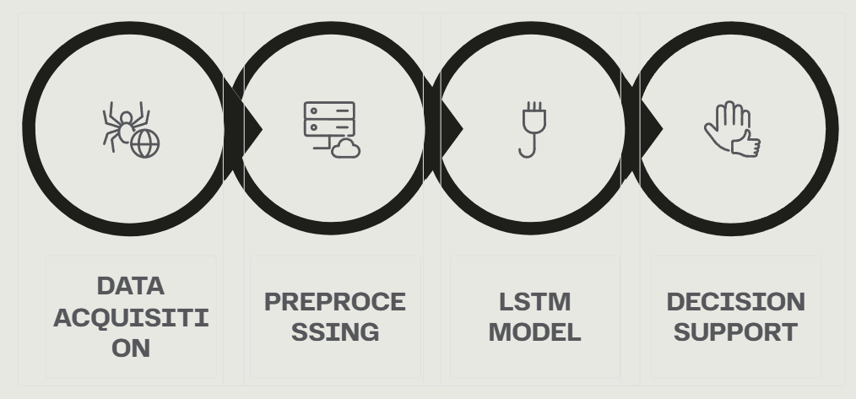
System Architecture Overview
Each module handles a distinct stage — from raw data collection to actionable consumer guidance — ensuring modularity and accuracy throughout the pipeline.
5

Slide 6
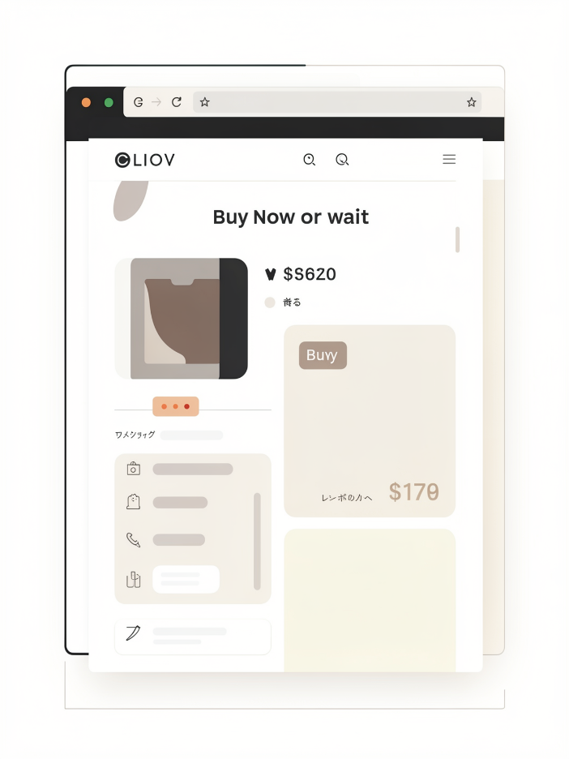
API & Browser Extension:-
Flask API
Exposes the trained LSTM model as a RESTful endpoint for real-time price predictions
Browser Extension
Delivers instant "Buy Now" or "Wait" recommendations directly on product pages
Consumer-Facing
Brings data-driven decisions to everyday shoppers, not just retailers
6

Slide 7
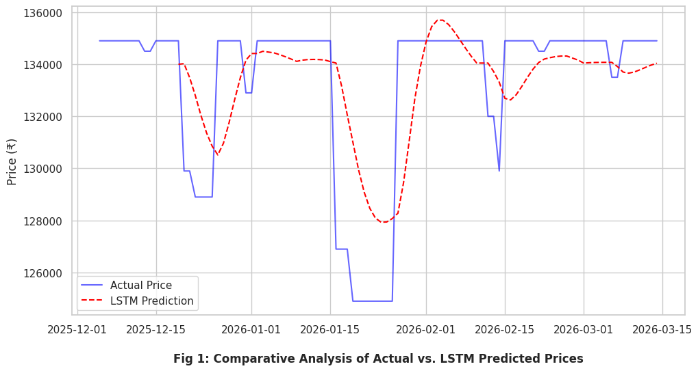
Comparative Analysis
This shows how closely the LSTM model (red dashed line) follows the Actual Price (blue line). It proves the model can accurately "mirror" real-world market shifts.
7

Slide 8
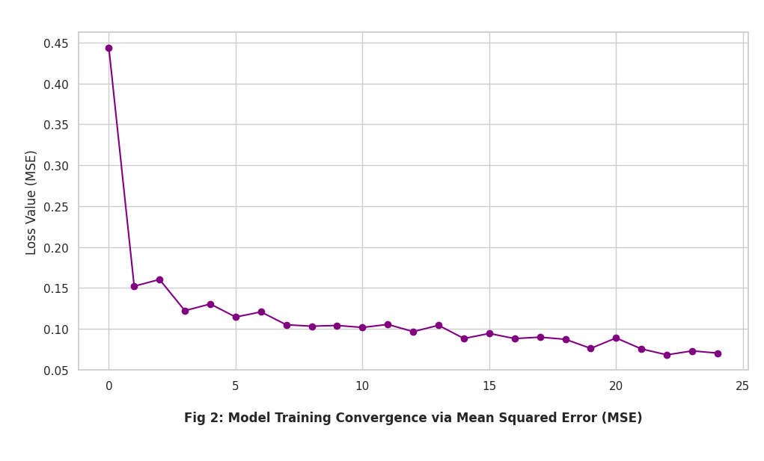
Model Training
This is a "Loss Curve". It shows the Mean Squared Error dropping over 25 training rounds (epochs), proving that the AI is successfully learning and not just guessing.
8

Slide 9
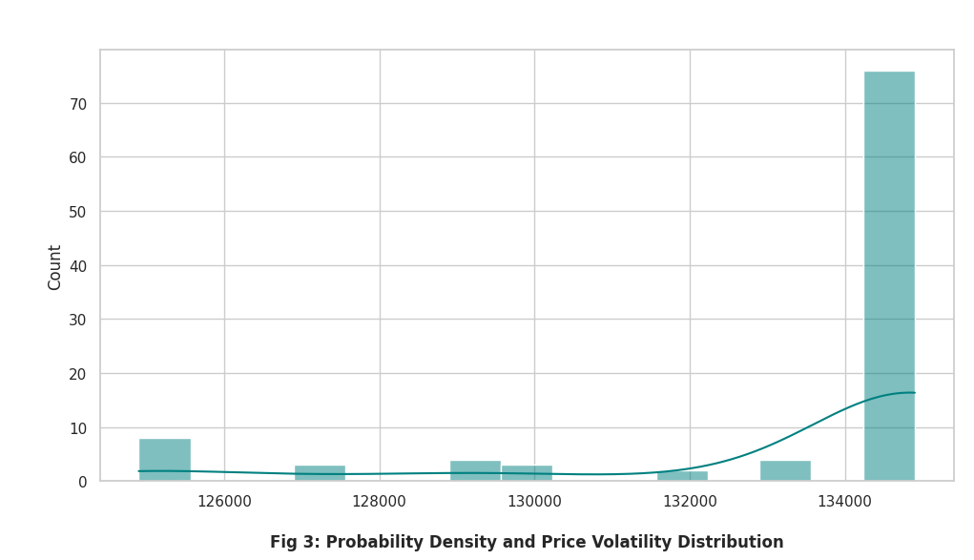
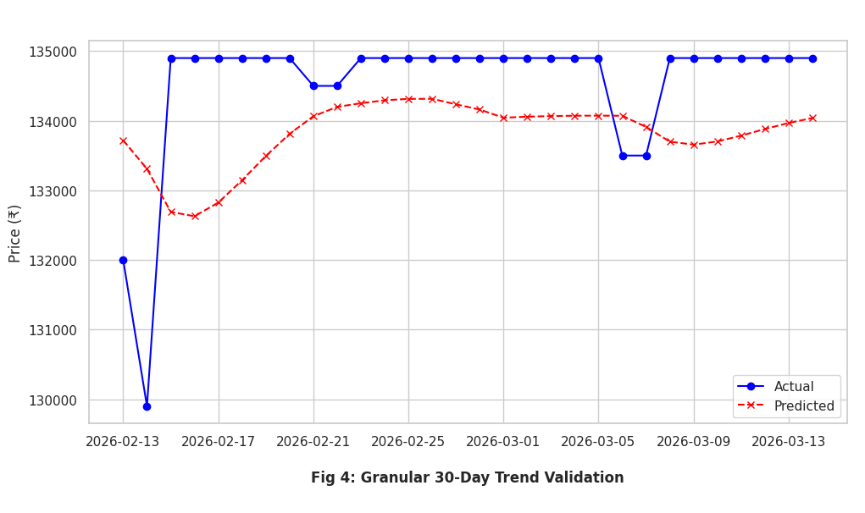
Probability Density
Figure 3 is your "Input Distribution" and Figure 4 is your "Inference Validation." Together, they prove that your SmartPrice AI isn't just guessing, but is actually mapping the historical probability of price movements to real-world outcomes.
9

Slide 10
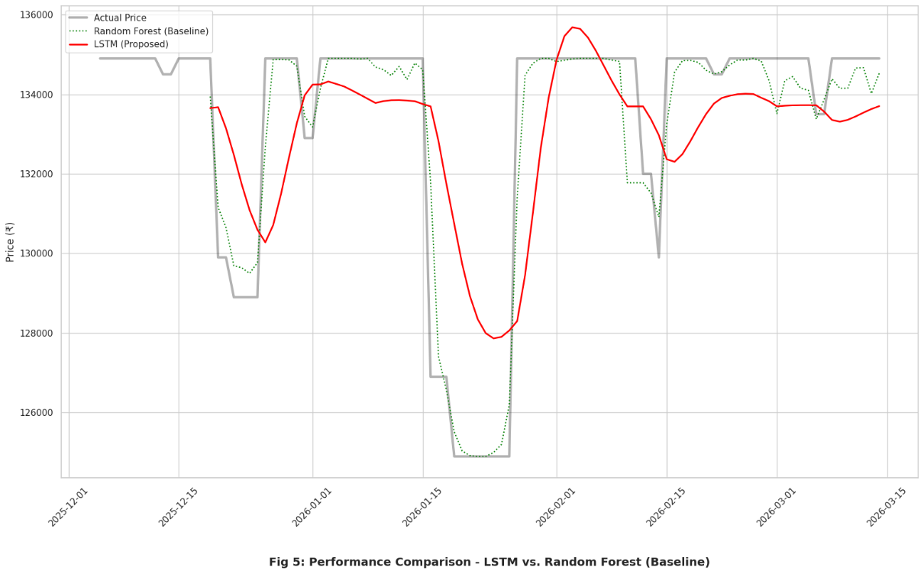
Results
Model | MAE | RMSE | Training Loss (MSE) | Prediction Accuracy
ARIMA | 1850 | 2360 | 0.012 | 82.4%
LSTM | 620 | 890 | 0.003 | 93.7%
10

Slide 11
Conclusion
This research proposed SmartPrice AI, an intelligent system that predicts online product price fluctuations.
The system uses time-series forecasting models (ARIMA and LSTM) to analyze historical price trends and estimate future prices.
Experimental results show that the LSTM model provides higher prediction accuracy and lower error values compared to traditional ARIMA models.
The system generates practical recommendations such as “Buy Now” or “Wait”, helping users make cost-effective purchasing decisions.
Overall, the proposed solution improves consumer decision-making and enhances the online shopping experience.
11

Slide 12
Thank You
12

